Slide 1

Server Management – Group Project IT Infrastructure Deployment for spark01a.com
Domain Name: spark01a.com
Group: 1
Group Members:
Zul Fadzli (Leader) – 2578624R
Azrin - 4868097C

Slide 2
Project Overview (½)
Project Background:
WebSmart Inc, a company started by SP graduates, was awarded a contract to design and implement an IT infrastructure for a new training organization.
Project Objective:
To set up a secure, scalable, and maintainable Windows Server–based IT environment that includes:
Domain Controller & Active Directory
DNS & DHCP Services
File Sharing & Group Policies
User Access Controls
Web Hosting

Slide 3
Project Overview (2/2)
Scope:
Plan and configure a domain: spark01a.com
Use virtual machines to simulate a real-world IT deployment
Implement Windows Server roles and test client connectivity
Tools and Technologies Used:
VMware Workstation
Windows Server 2019
Windows 10 (Client01)
Active Directory Domain Services (AD DS)
DNS & DHCP Server Roles
File Server Resource Manager
Group Policy Management Console (GPMC)
PowerShell for automation
Internet Information Services (IIS)

Slide 4

Domain Organizational Structure (1/3)
Organizational Units (OUs):
🧑‍💼 Managers
🧑‍🏫 Coaches
👩‍🎓 Trainees
👥 Visitors
Security Groups:
DLManagers, DLCoaches, DLTrainees, DLVisitors
BudgetR, BudgetW
LogisticsR, LogisticsW
DLClients

Slide 5
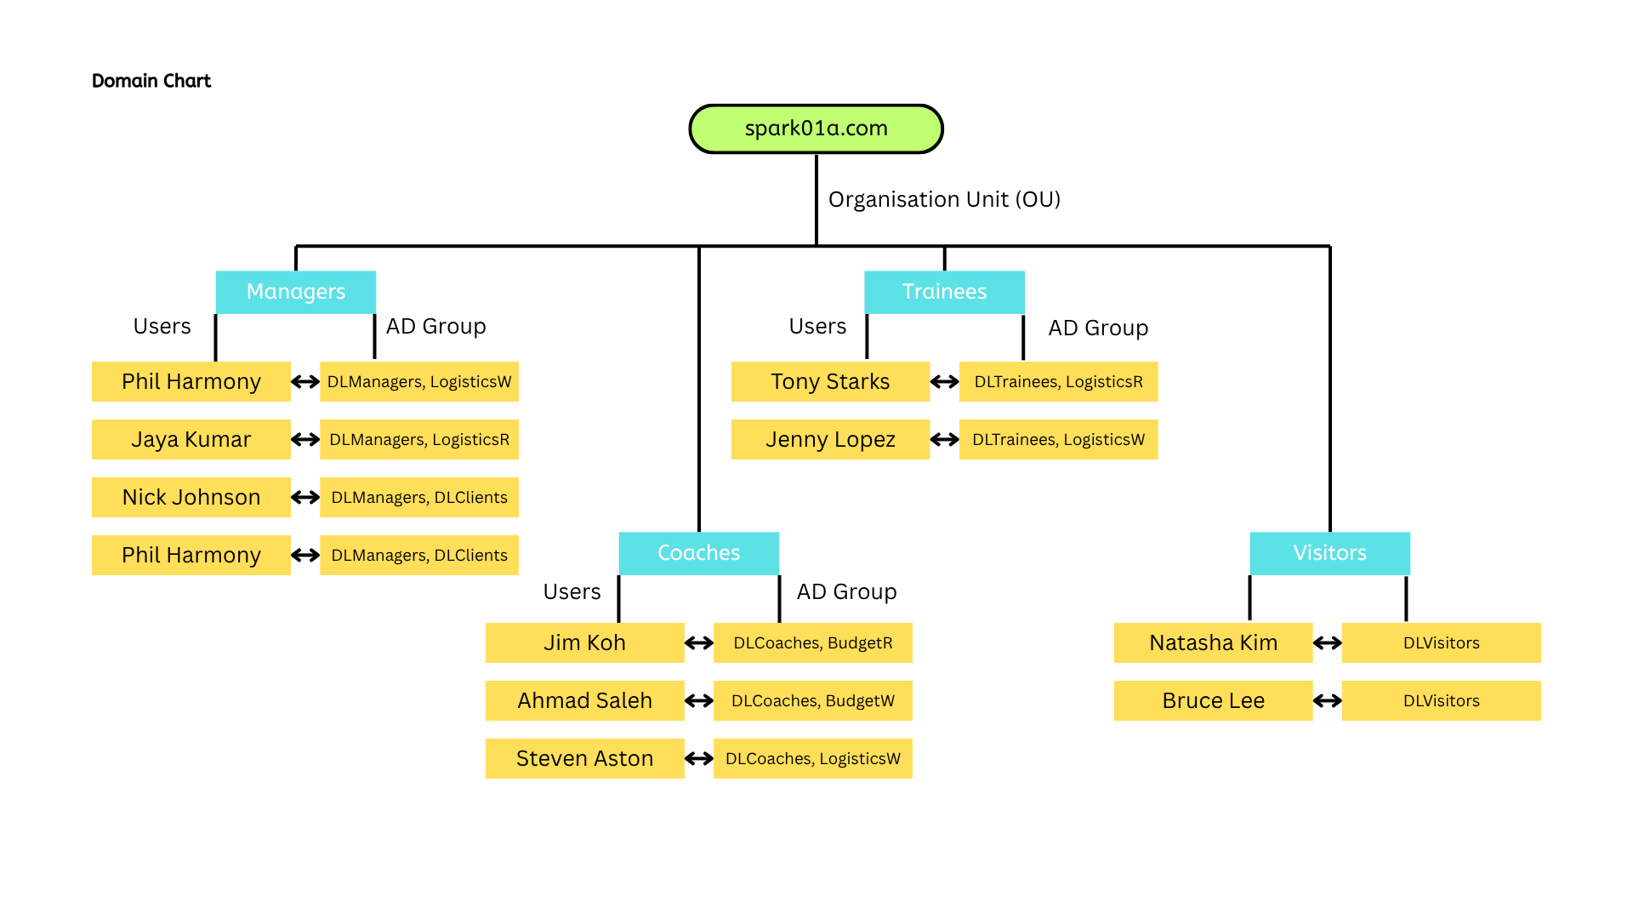
Domain Organizational Structure (2/3)

Slide 6
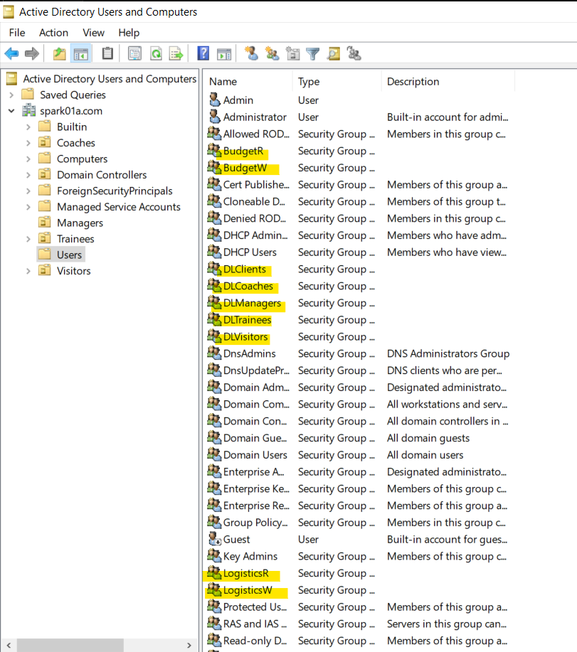
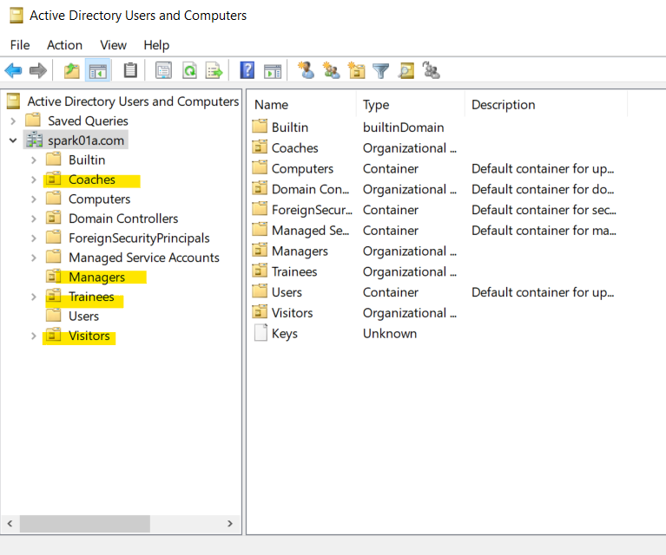
Domain Organizational Structure (3/3)

Slide 7
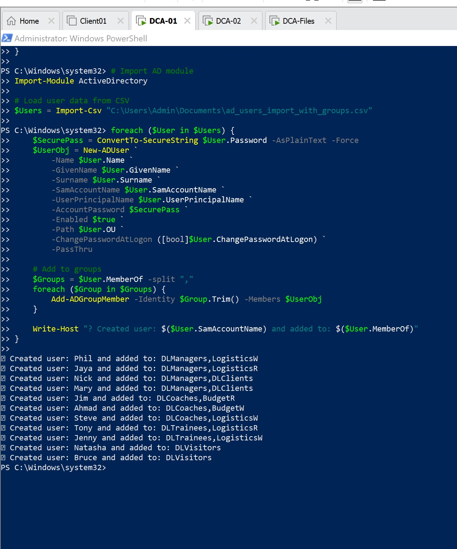
Bulk Import of Domain Users (Table) Implementation with PowerShell (run as Admin) (1/5)
Step 1: Import Active Directory Module
# Import AD module
Import-Module ActiveDirectory
What it does :
This command loads the Active Directory PowerShell module, which gives access to cmdlets like New-ADUser, Add-ADGroupMember, etc.
Why it's needed:
Without this, PowerShell won’t recognize AD-related commands. This module must be loaded first on machines with RSAT tools or Domain Controllers.

Slide 8
Bulk Import of Domain Users (Table) Implementation with PowerShell (run as Admin) (2/5)
Step 2: Load Users from CSV File
What it does :
Reads the .csv file containing user information and stores each row as a user object in the $Users variable for later processing.
Step 3: Loop Through Each User
What it does:
Begins a loop that processes each user from the CSV one at a time.
$Users = Import-Csv "C:\Users\Admin\Documents\ad_users_import_with_groups.csv"
foreach ($User in $Users) {

Slide 9
Bulk Import of Domain Users (Table) Implementation with PowerShell (run as Admin) (3/5)
Step 2: Load Users from CSV File
What it does :
Reads the .csv file containing user information and stores each row as a user object in the $Users variable for later processing.
Step 3: Loop Through Each User
What it does:
Begins a loop that processes each user from the CSV one at a time.
$Users = Import-Csv "C:\Users\Admin\Documents\ad_users_import_with_groups.csv"
foreach ($User in $Users) {

Slide 10
Bulk Import of Domain Users (Table) Implementation with PowerShell (run as Admin) (4/5)
Step 4: Convert Password to Secure Format
What it does :
Takes the plain-text password from the CSV and converts it to a secure string, which is required by the New-ADUser command.
Step 5: Create the User in Active Directory
What it does:
Creates a new user in the specified OU with all required details (name, username, password, etc.). The -PassThru option returns the user object for the next step.
$SecurePass = ConvertTo-SecureString $User.Password -AsPlainText -Force
$UserObj = New-ADUser `
-Name $User.Name `
-GivenName $User.GivenName `
-Surname $User.Surname `
-SamAccountName $User.SamAccountName `
-UserPrincipalName $User.UserPrincipalName `
-AccountPassword $SecurePass `
-Enabled $true `
-Path $User.OU `
-ChangePasswordAtLogon ([bool]$User.ChangePasswordAtLogon) `
-PassThru

Slide 11
Bulk Import of Domain Users (Table) Implementation with PowerShell (run as Admin) (5/5)
Step 6: Add User to Assigned AD Groups
What it does :
Splits the group list (from CSV) into individual groups and adds the new user to each one using Add-ADGroupMember.
Step 7: Output Confirmation Message
What it does:
Prints a message to the console confirming the username and groups that the user has been added to.
$Groups = $User.MemberOf -split ","
foreach ($Group in $Groups) {
Add-ADGroupMember -Identity $Group.Trim() -Members $UserObj
}
Write-Host "? Created user: $($User.SamAccountName) and added to: $($User.MemberOf)"

Slide 12

Network Infrastructure Diagram
Purpose:
To visually show the network setup of your virtual environment:
Server roles
IP addressing
DHCP configuration
How the client connects

Slide 13
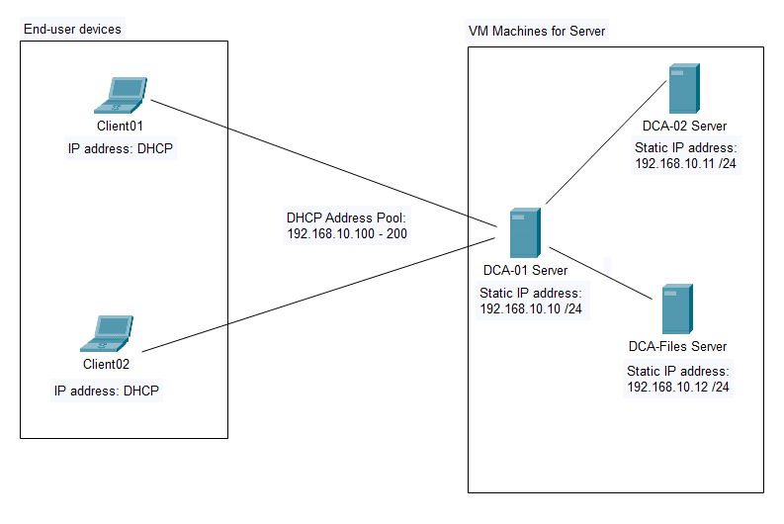

Network Infrastructure Diagram

Slide 14
Network Infrastructure Diagram
VM Name | Role(S) | IP Address
DCA-01 | Primary DC, DNS, DHCP | 192.168.10.10
DCA-02 | DHCP & DNS Redundancy | 192.168.10.11
DCA-Files | File Server | 192.168.10.12
Client01 | End-user | DHCP
Clien02 | End-user | DHCP
DHCP Address Pool
192.168.10.100 - 192.168.10.200

Slide 15
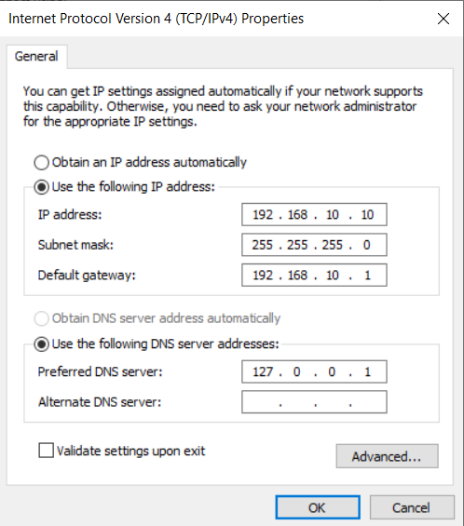
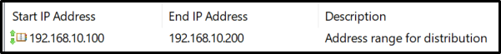
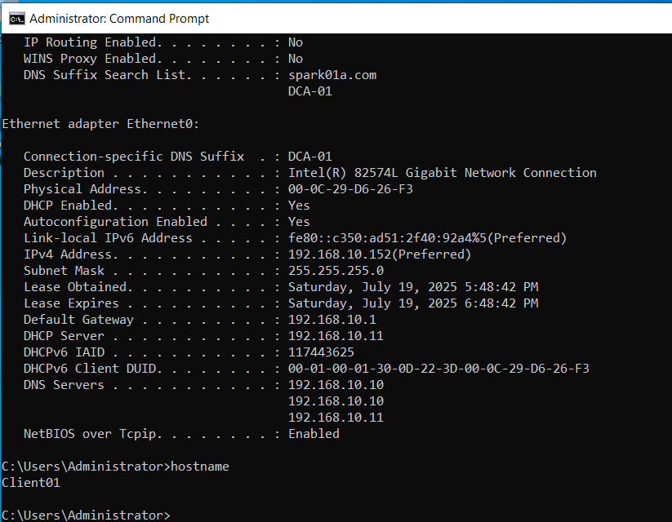
Network Infrastructure Diagram
Configuration screenshots
DCA-01 static IP
DHCP – Address Pool
Client01 DHCP IP

Slide 16

File Shares
🎯 Purpose:
To document the shared folders hosted on DCA-Files, how they’re organized, and who has access (read/write) based on AD group memberships.
✅ Main Shared Folder Location
Server: DCA-Files
Drive: E:\shares
Shared via UNC: \\DCA-Files\shares

Slide 17
File Shares
📁 Departmental Shares (mapped to G:)
Department | Folder Path | UNC Path | Group Access
Coaches | E:\shares\coaches | \DCA-Files\shares\coaches | DLCoaches
Trainees | E:\shares\trainees | \DCA-Files\shares\trainees | DLTrainees
Manager | E:\shares\managers | \DCA-Files\shares\managers | DLManagers
📂 Project Shares (mapped to P:)
Share Name | Local Path | UNC Path | Read Group | Write Group
Budget | E:\shares\projects\budget | \DCA-Files\projects\budget | BudgetR | BudgetW
Intranet | E:\shares\projects\intranet | \DCA-Files\projects\intranet | Authenticated Users | DLManagers
Logistics | E:\shares\projects\logistics | \DCA-Files\projects\logistics | LogisticsR | LogisticsW
📝 Note:
No groups were assigned Full Control to the shared folders to minimize risk and maintain security. By limiting access to only Read and Write, we prevent users from accidentally or maliciously modifying permissions, deleting folders, or taking ownership of critical files.

Slide 18
File Shares
Available File Shares Table
Share | Local Path | Read | Write | Full Control
Budget | E:\shares\projects\budget | BudgetR | BudgetW | -
Intranet | E:\shares\projects\intranet | Authenticated Users | DLManagers | -
Logistics | E:\shares\projects\logistics | LogisticsR | LogisticsW | -
Coaches | E:\shares\coaches | DLCoaches | DLCoaches | -
Trainees | E:\shares\trainees | DLTrainees | DLTrainees | -
Managers | E:\shares\managers | DLManagers | DLManagers | -
✅ Note: No groups are given Full Control — permissions are limited to Read and Write based on their group roles.

Slide 19
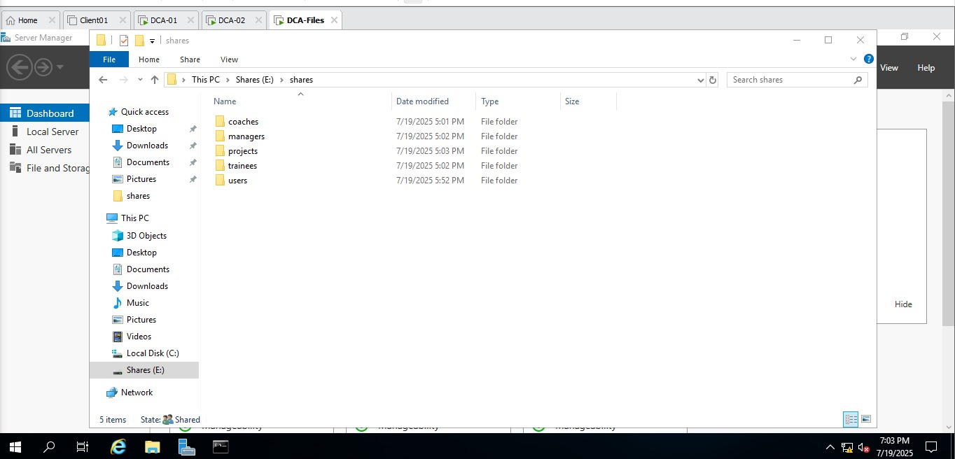
File Shares
Configuration screenshots (shares folder)

Slide 20
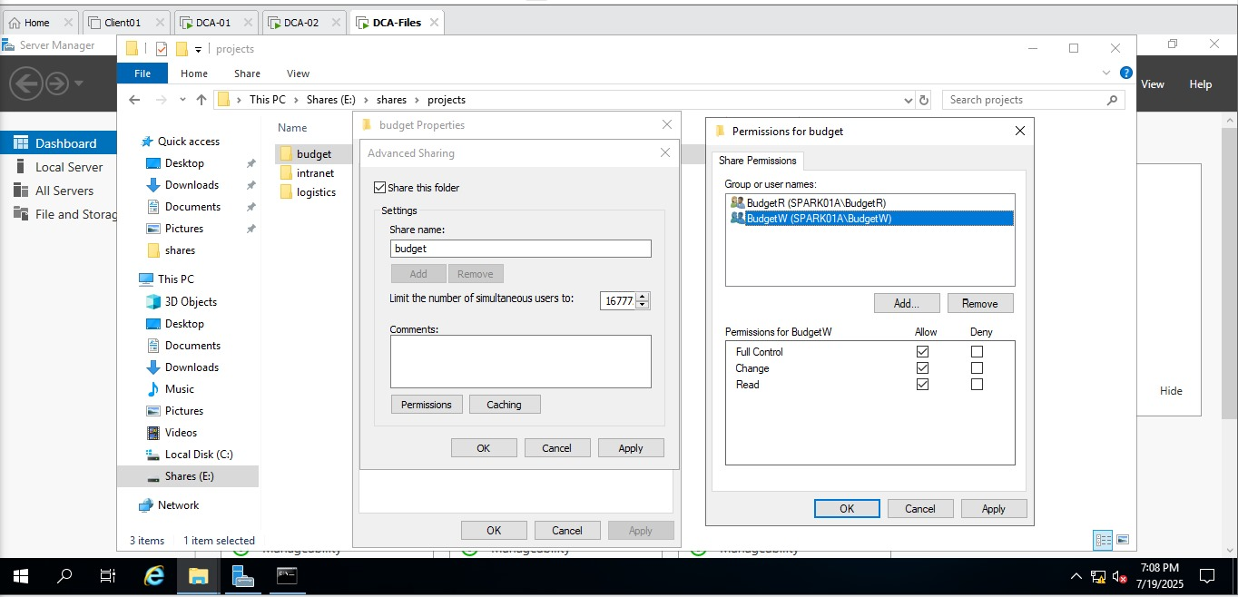
File Shares
Configuration screenshots
(budget folder)

Slide 21
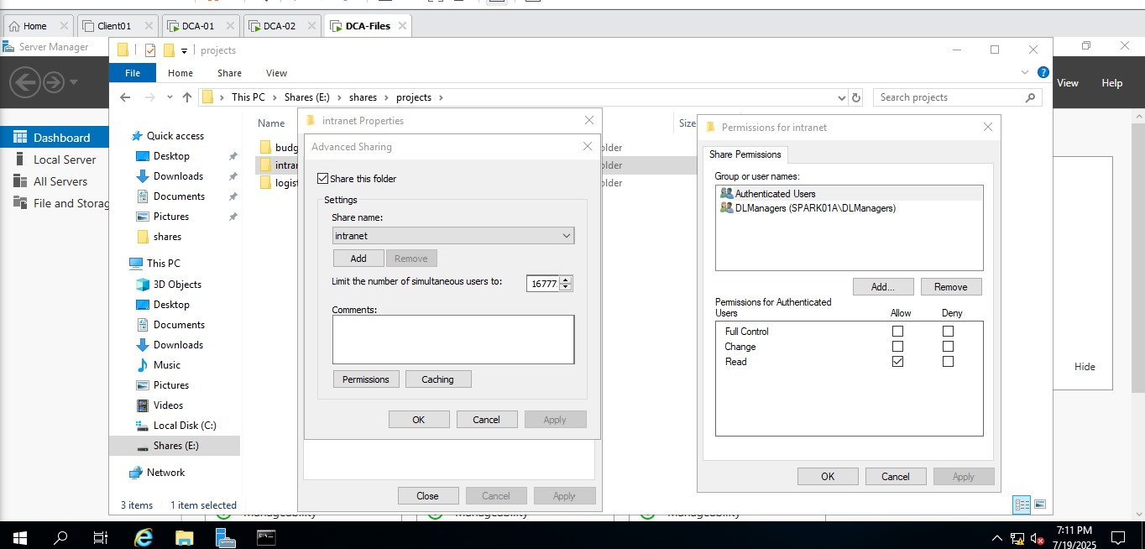
File Shares
Configuration screenshots
Intranet folder

Slide 22
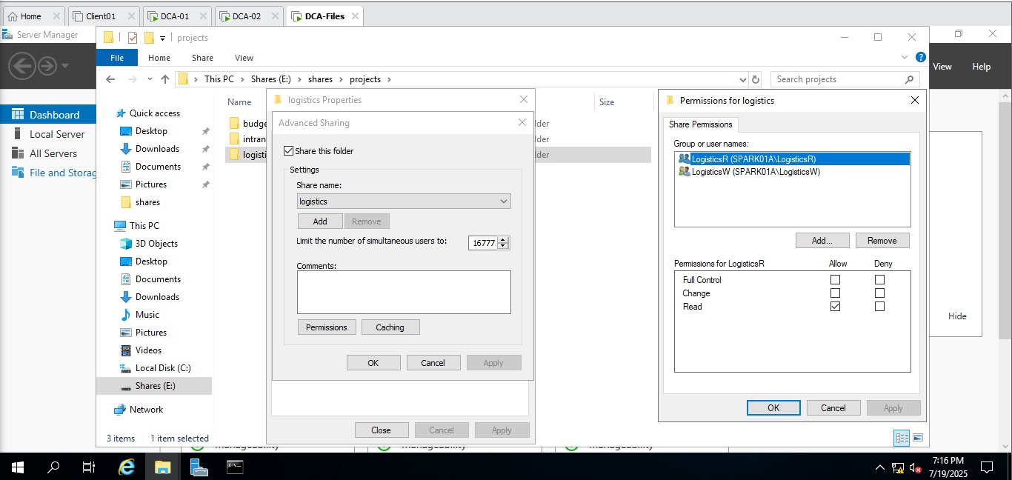
File Shares
Configuration screenshots
Logistics folder

Slide 23

Group Policies and Restrictions
🎯 Purpose:
To show the GPOs (Group Policy Objects) we configured, where they are applied, and what settings were implemented for each OU or group.

Slide 24
Group Policies and Restrictions
📝 GPO Summary Table
GPO Name | Linked to | Group Policy | Details
Default Domain Policy | Domain | Minimum password length | 9 characters
Default Domain Policy | Domain | Minimum password age | 90 days
Default Domain Policy | Domain | Account lockout threshold | 5 attempts
Default Domain Policy | Domain | Disable first sign-in animation | Enabled
Default Domain Policy | Domain | Set default homepage to www.sparkxxy.com | Internet Explorer / browser setting
User Restirction – MGR Exempted | Domain (except Managers) | Remove Recycle Bin, set wallpaper/screensaver | Applied to all except Managers OU
Folder Redirection GPO | DLCoaches OU | Redirect Desktop & Documents | To E:\shares\redirected on DCA-Files
Mapping of Project Folder | Domain | Map P:\ to \DCA-Files\projects | Files\projects Users see only folders they have access to
G Drive for coaches | DLCoaches OU | Map G:\ to \DCA-Files\shares\coaches | Based on department OU
- | Domain Users | 50MB home drive quota, block .cmd, .exe | Configured using FSRM
Visitor Restrictions GPO | Visitors OU | Block access to Control Panel & personalization | Enabled

Slide 25
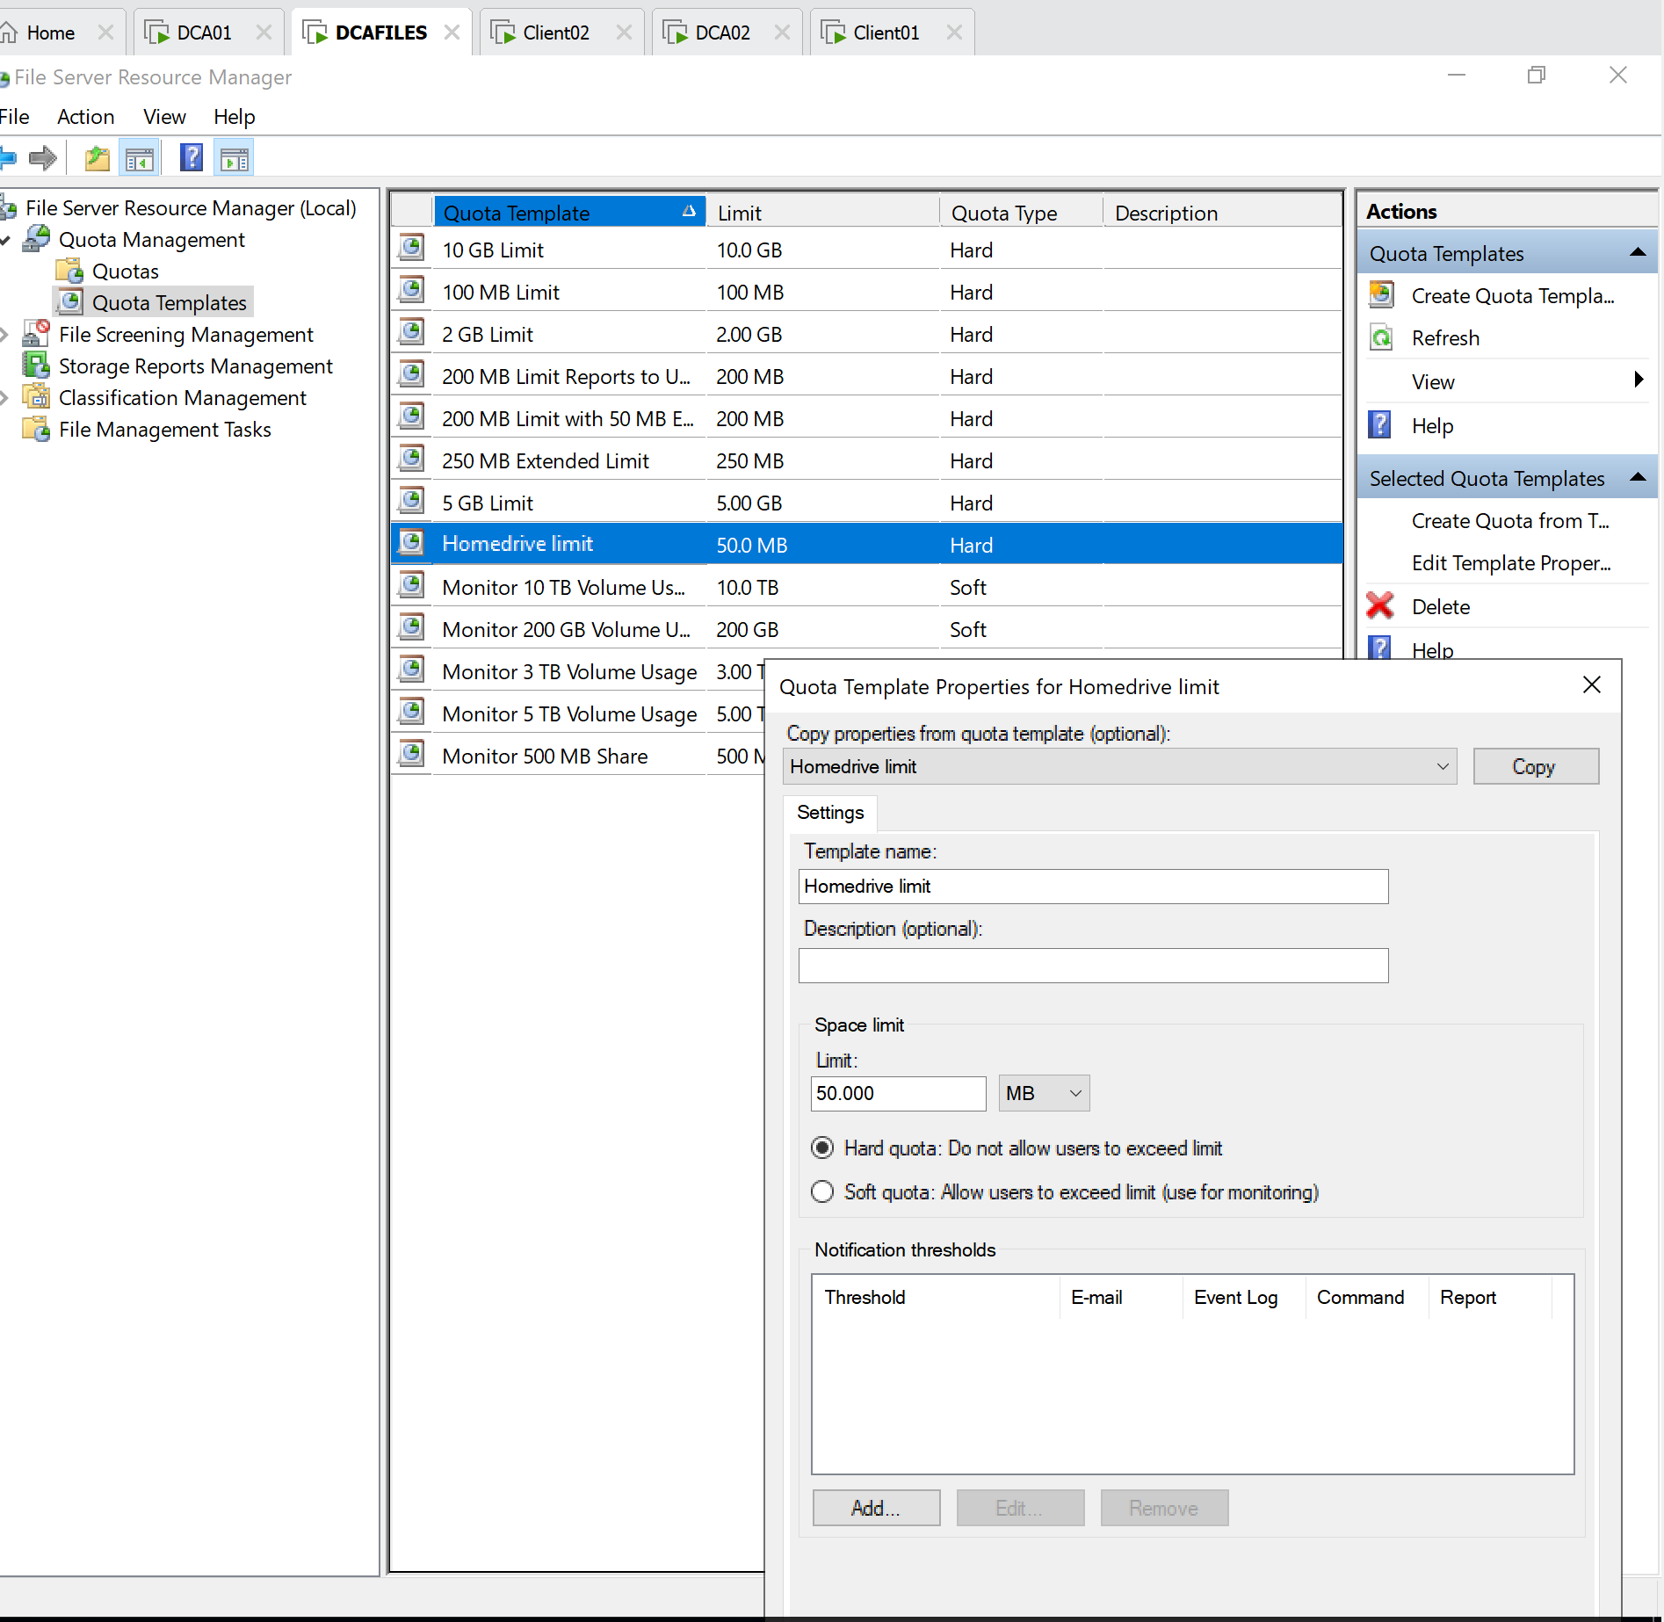
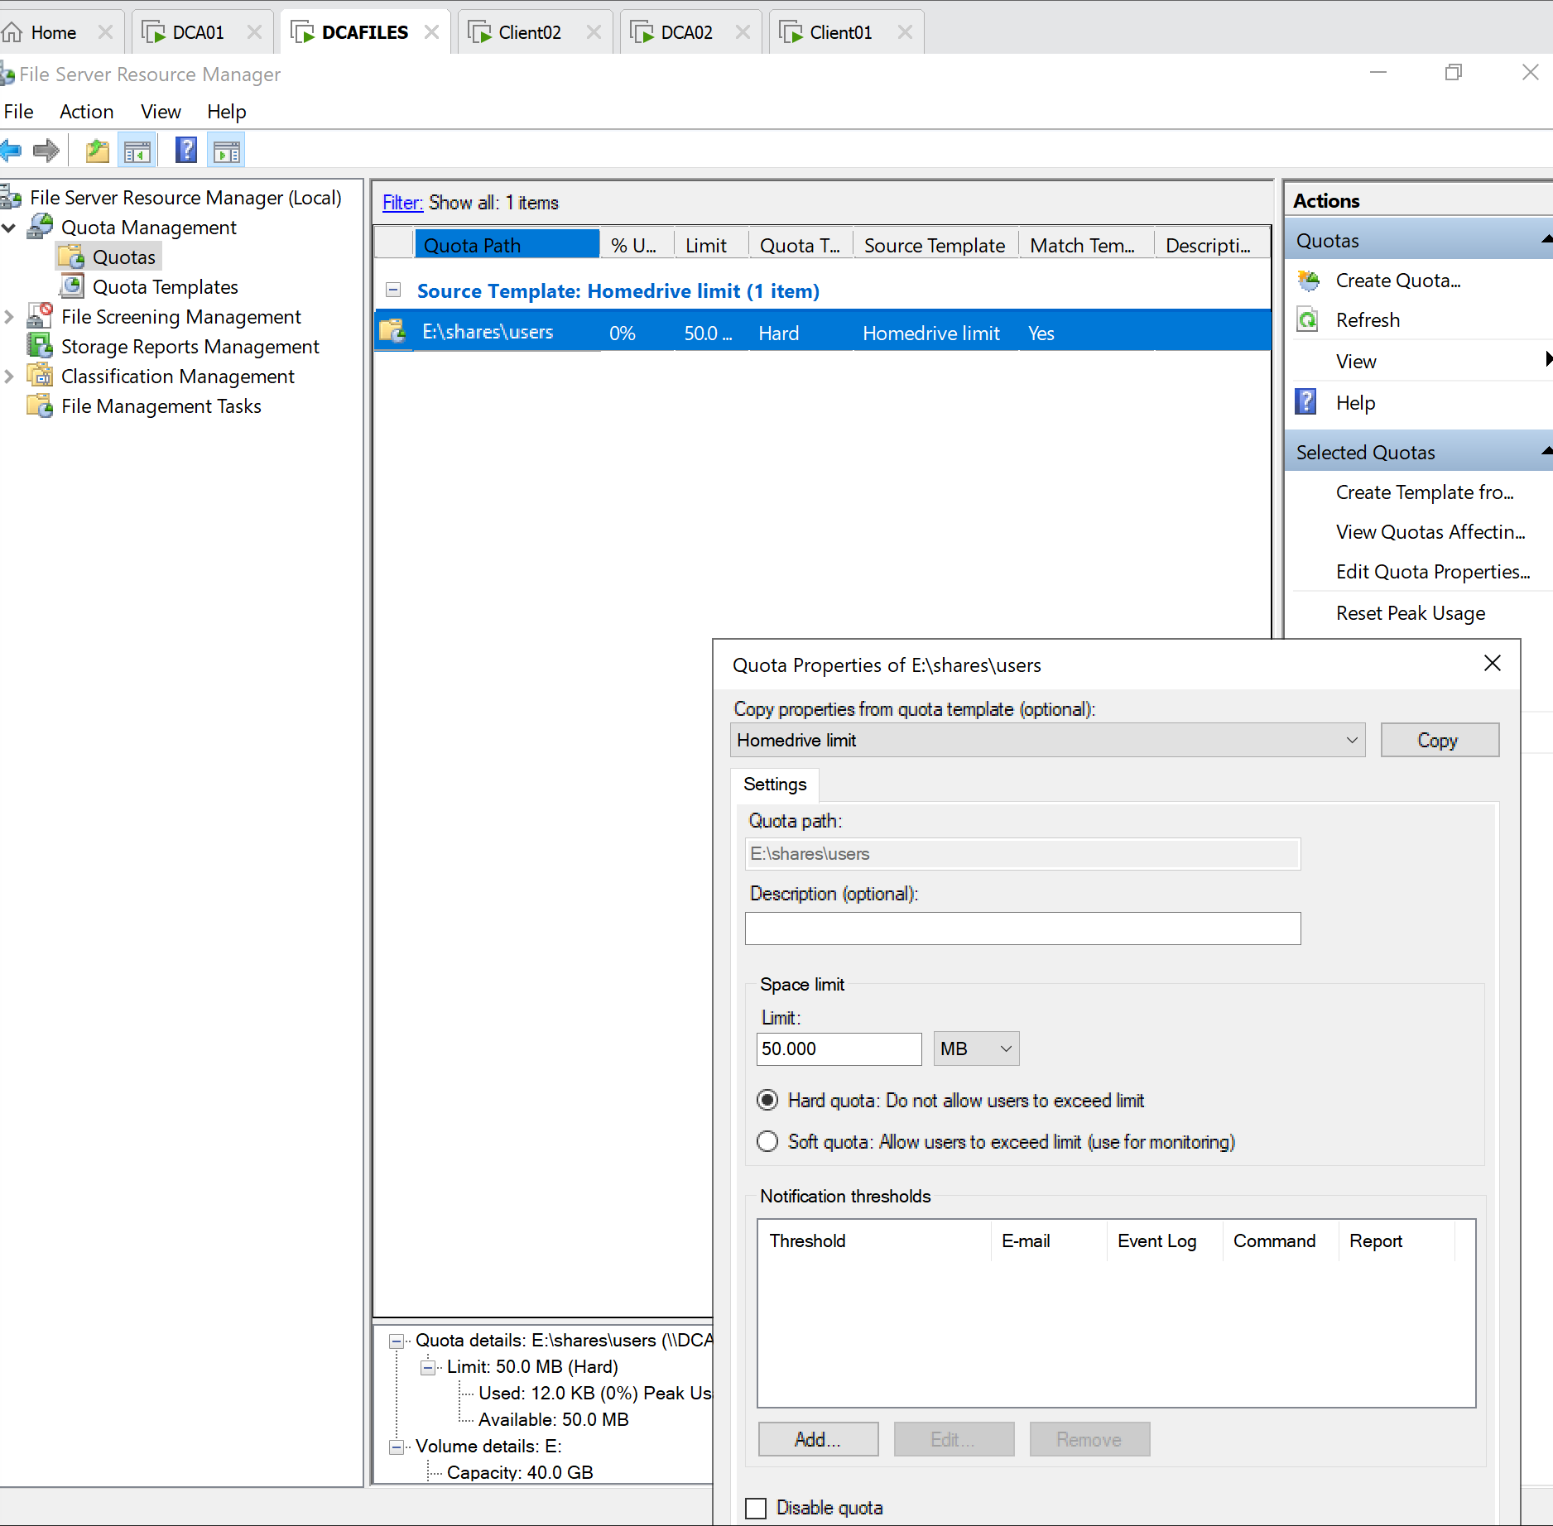
Settings in DCAFILES for size limit and Prevent storing .cmd and .exe

Slide 26
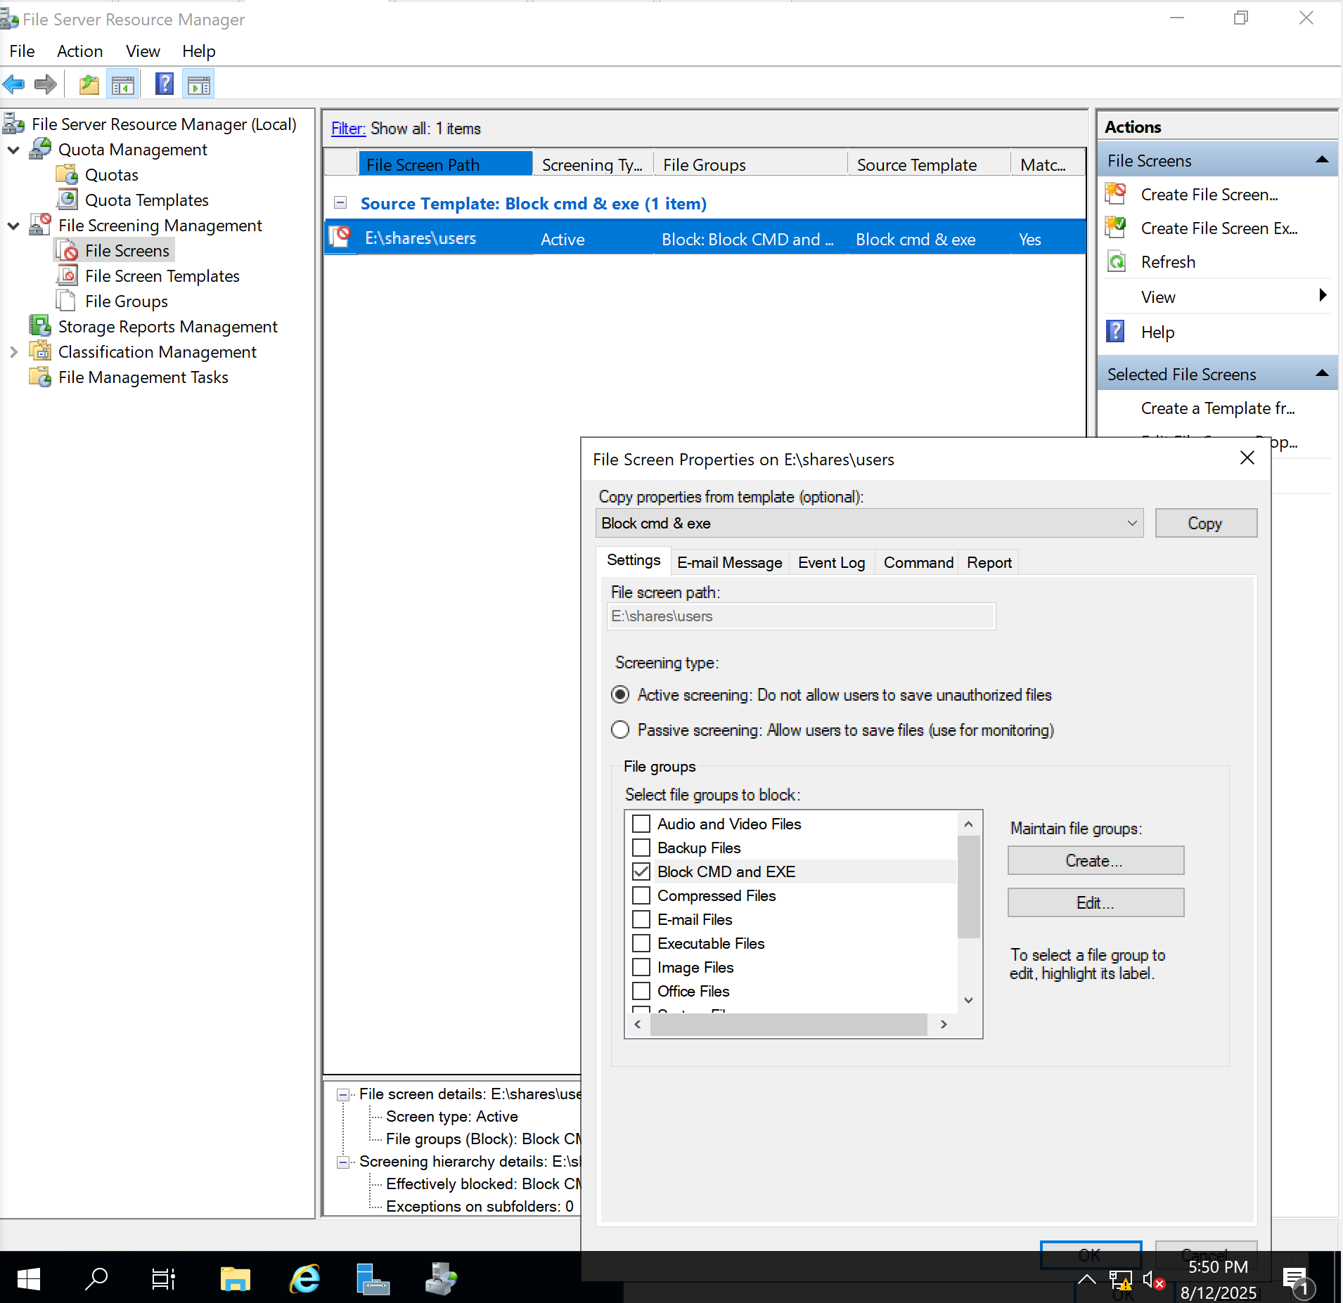
CON’T

Slide 27
Group Policies and Restrictions
📌 Bullet Summary of Policies Implemented:
Password Policy: Enforced strong passwords and aging
User Restrictions: Visitors can’t open Control Panel
Drive Mapping:
G:\ mapped to department folders
P:\ mapped to project shares
U:\ mapped as home drive (per user)
Folder Redirection: Desktop/Documents redirected for Coaches
Quota & File Screening: 50MB quota + .exe/.cmd blocked on U:\

Slide 28
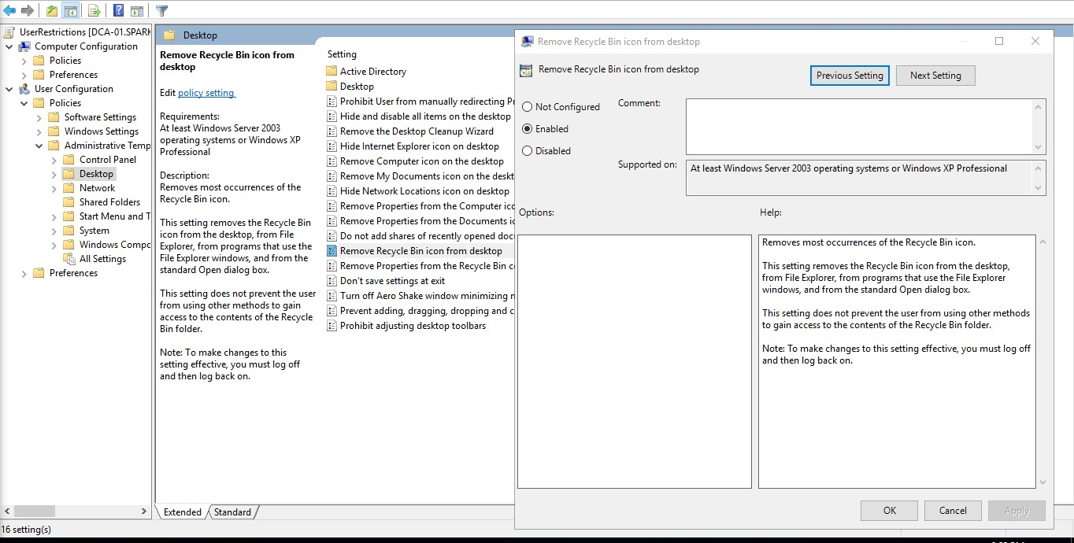
Group Policies and Restrictions
Removed Recycle Bin icon from desktop policy (enabled)

Slide 29
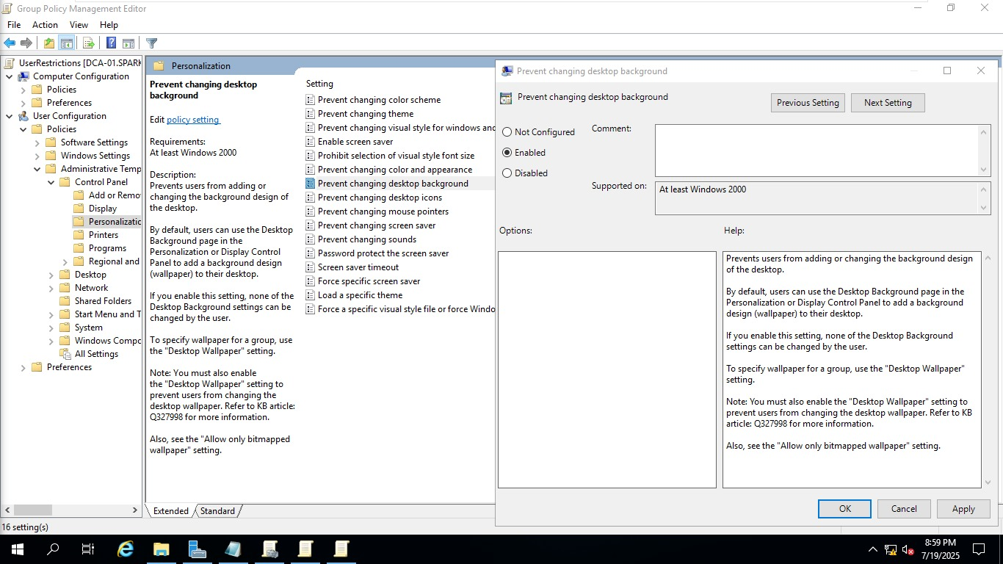
Group Policies and Restrictions
Prevent changing desktop background policy
(enabled)

Slide 30
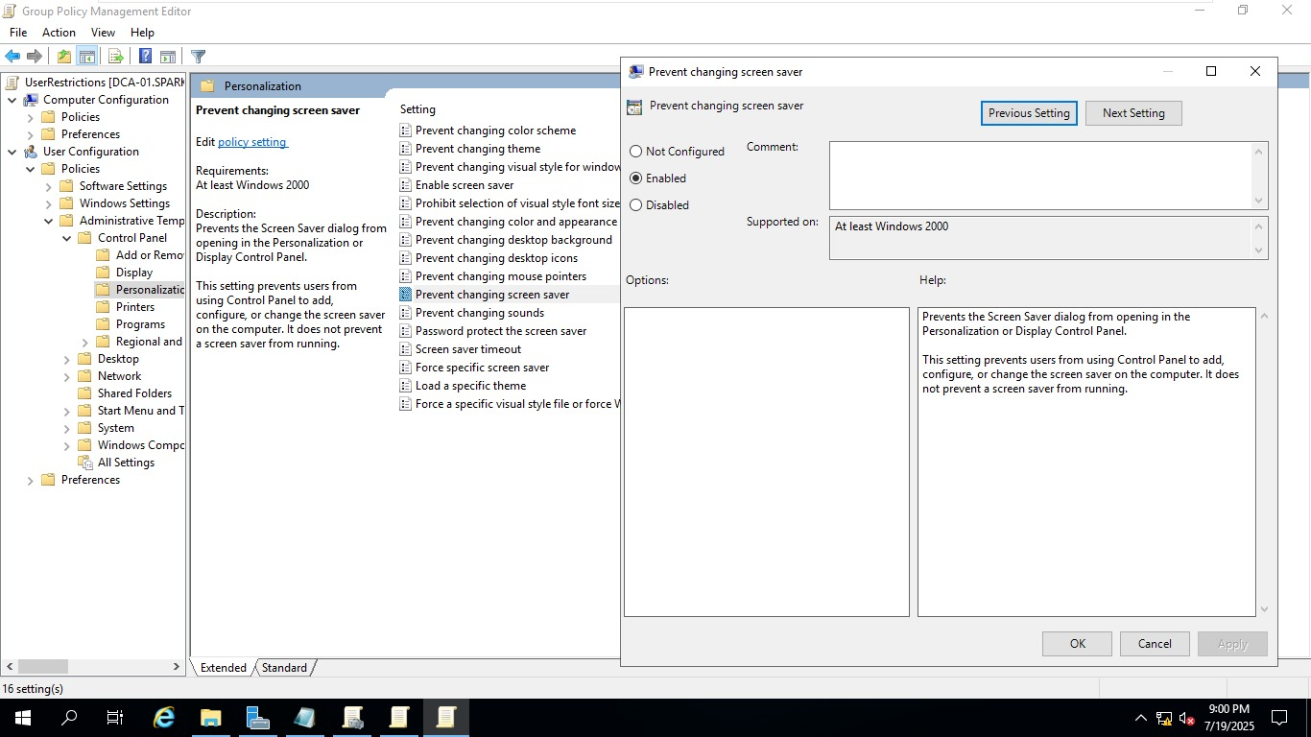
Group Policies and Restrictions
Prevent changing screen saver policy
(enabled)

Slide 31
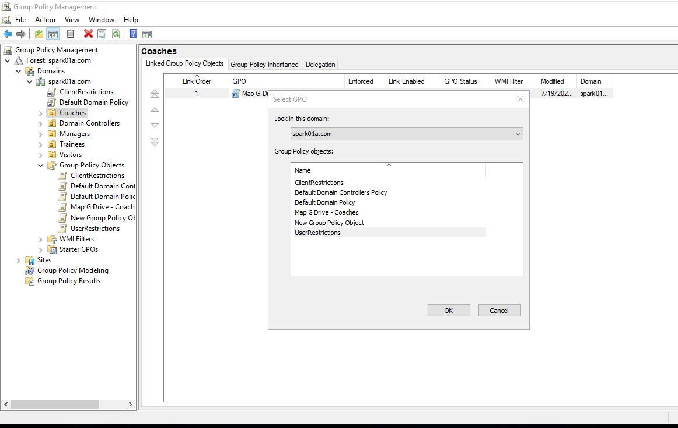
Group Policies and Restrictions
Linked Group Policy Objects
(except for Managers)

Slide 32
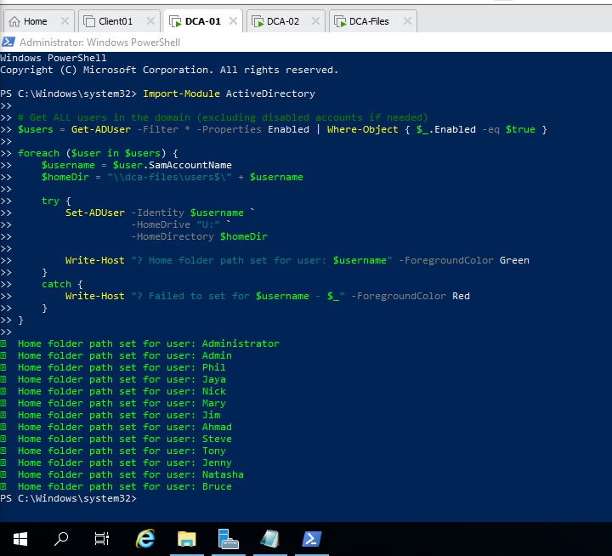
Automated Home Folder Creation and Mapping for (Drive U:)
Additional Features:
🧩 Benefits:
Eliminates manual user-by-user home folder setup
Reduces time and human error
Ensures consistent mapping of U:\ drive
Enhances user experience with isolated storage

Slide 33
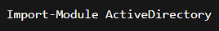
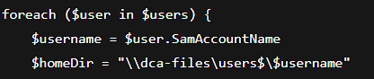
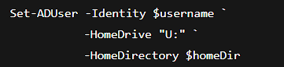
📝 What the Script Does (Brief Breakdown):
Loads the Active Directory module to use AD-related commands.
2) Retrieves a list of all enabled users in the domain.
3) Loops through each user and dynamically creates a home directory path for them on the file server (DCA-Files) under \\dca-files\users$\
4) Assigns U: as the mapped network drive for each user, pointing to their personal home folder.

Slide 34
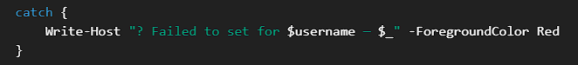
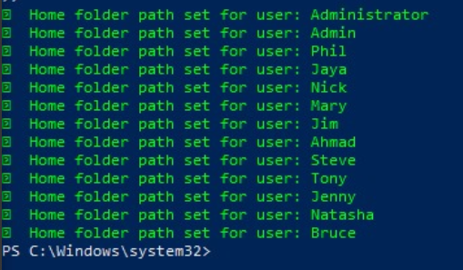
📝 What the Script Does (Brief Breakdown):
5) Outputs a success message in green for each user processed.
6) If there's an error assigning the home drive, it prints a red error message with details.

Slide 35
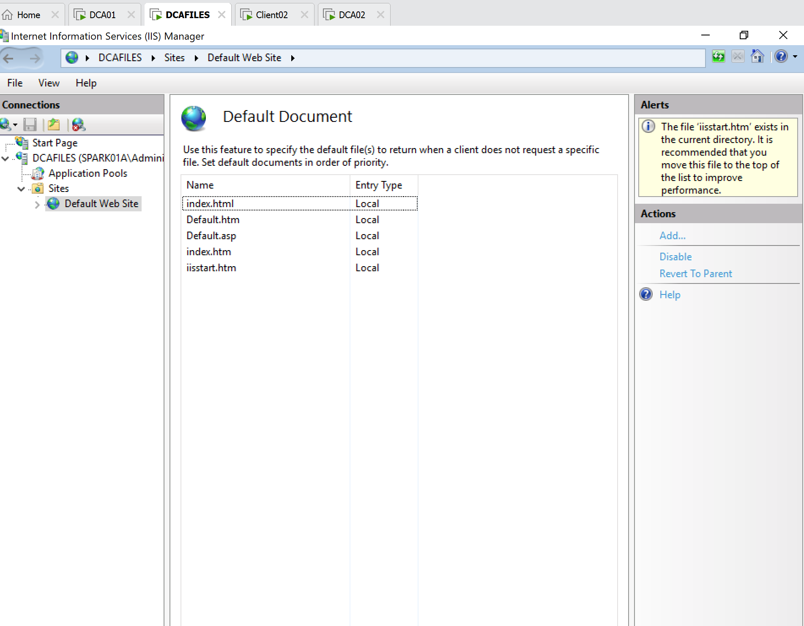
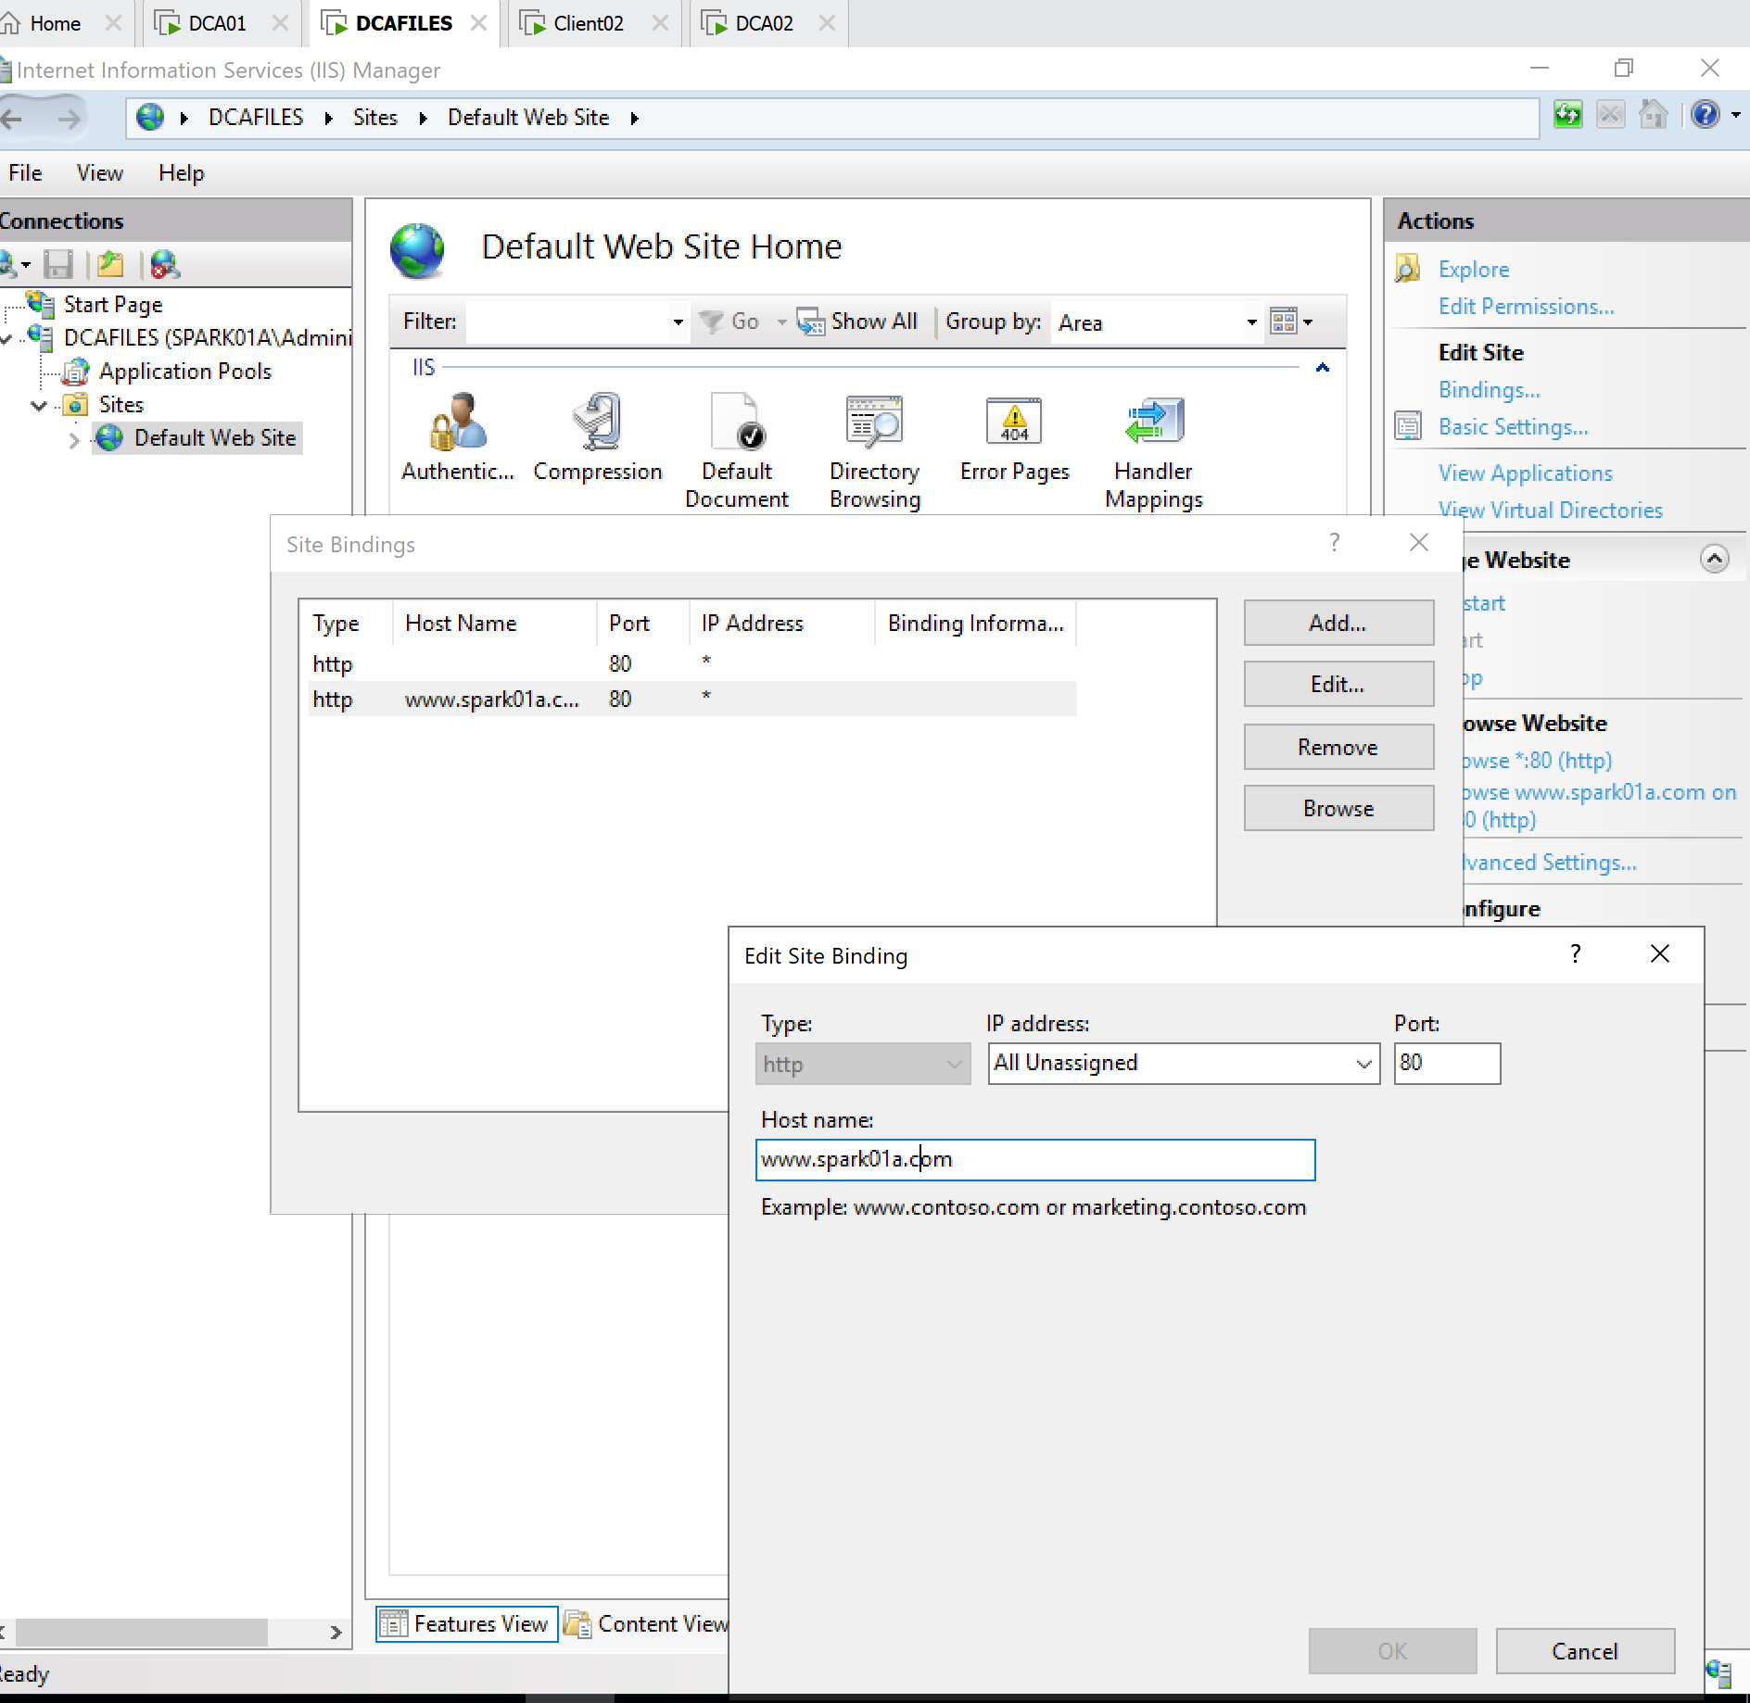
Web server (DCAFILES)

Slide 36
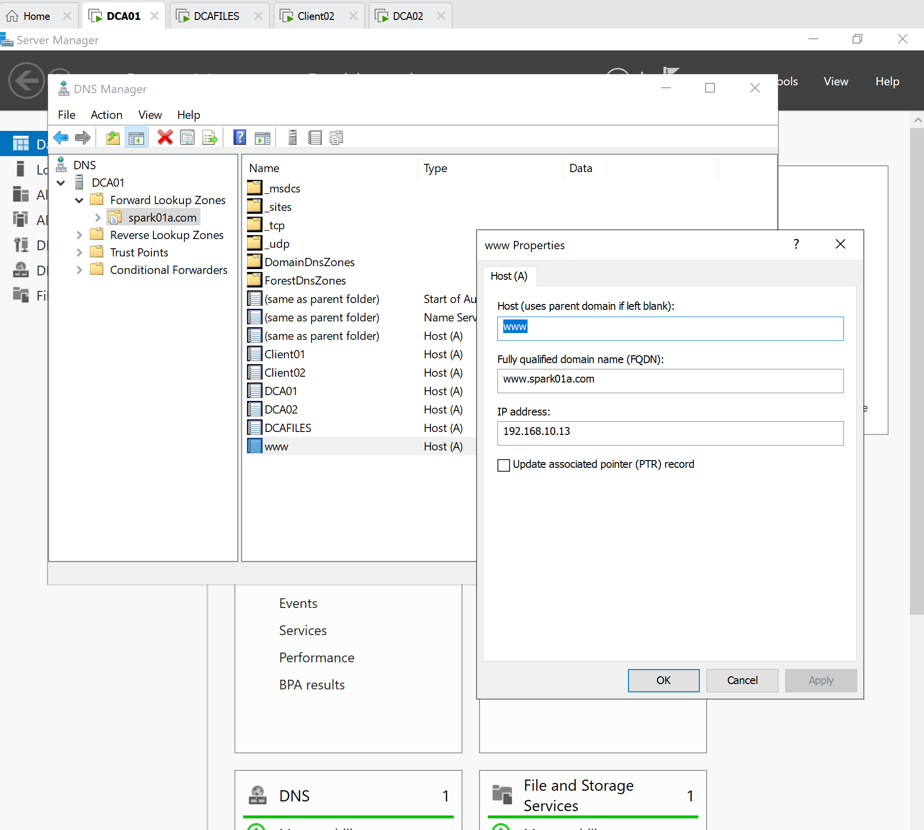
Con’t

